Slide 1
Electrostatics
Static Electricity

Slide 2
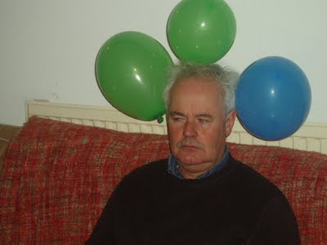
3 Types of charges
Positive (+)
Proton
Negative (-)
Electron
Neutral
Equal protons & electrons

Slide 3
Positive Charged objects
Positive charged objects means they have extra protons than electrons.
4 – 5 +
Overall Positive
+
-
+
-
+
+
+
+
-
-

Slide 4
Negative Charged Objects
Negative charged objects means they have extra electrons than protons.
5 – 4 +
Overall Negative
-
+
+
-
-
-
+
-
+
-

Slide 5
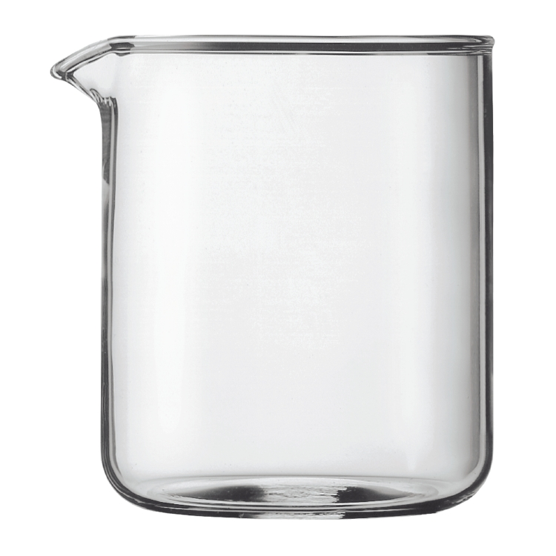
Neutral Objects
A neutral object has equal protons & electrons
4 – 4 +
Neutral
+
-
-
+
-
+
-
+

Slide 6
Charge Interactions
2 charges |  | What occurs
+ & +
+
+
Repel
- & -
-
-
Repel
+ & -
+
-
Attract
+ & Neu
+
Attract
- & Neu
-
Attract
Neu & Neu
?
Nothing
Basic Rules
Like charges Repel
Opposites attract

