Slide 1
Punnett Squares

Slide 2
Genetics
Genetics is the study of inheritance of genes.
i.e. genetics is how traits are passed down from parents to offspring
Every individual offspring inherits at least two copies of every gene – one from the mother and one from the father.
Each version of a gene is called an allele.
You inherit at one allele from both parents for every gene.
Genes can either be dominant or recessive –
Dominant genes are always expressed if they are present
Recessive genes are only expressed if no dominant genes are present.
Source: blogography.com
Source: techcynic.wordpress.com

Slide 3
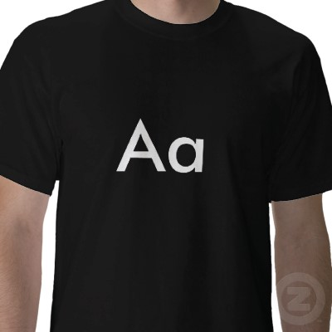
Homozygous vs. Heterozygous
The combination of genes that you have can be described by homozygous or heterozygous.
Homozygous means that both of your genes are the same – either both are dominant or both are recessive
AA would be Homozygous Dominant (both alleles are dominant)
aa would be Homozygous Recessive (both alleles are recessive)
Heterozygous means that you have both a dominant and a recessive copy of a gene.
Aa would be Heterozygous (one dominant allele, one recessive allele)
Source: zazzle.com

Slide 4
Genotype vs. Phenotype
Genotype is the term for the genes that an organism has.
Phenotype are the physical characteristics created by the combination of genes that an organism has.

Slide 5
Punnett Squares
A Punnett Square is a tool used for determining the possible genetic outcomes of the offspring of two parents
Punnett Squares are can be used to determine the parents’ or offsprings’ phenotypes and genotypes.
Punnett Squares show all of the possible combinations of offspring genotypes that a couple could have.
A A
a
a
Aa Aa
Aa Aa

Slide 6
Sex Determination
Female
X X
X
Y
XX
XX
Male
XY
XY
Percentages:
XY Male 50%
XX Female 50%

Slide 7
Example 1
Brown eyes are Dominant
Blue eyes are Recessive
What are the possible offspring of the following situation
Homozygous Brown (Pure)
Homozygous Blue (Pure)
B
b
BB
bb

Slide 8
Example 1
B B
Genotypes:
Bb
b
b
Bb
Bb
Phenotypes:
Bb
Bb
Percentages:
Bb 100%
Brown eyes 100%

Slide 9
Example 2
What are the possible offspring of the following situation
Heterozygous Brown (Hybrid)
Homozygous Blue (Pure)
Bb
bb

Slide 10
Example 2
B b
Genotypes:
Bb
bb
b
b
Bb
bb
Phenotypes:
Bb
bb
Percentages:
Bb 50% bb 50%
Brown eyes 50% Blue eyes 50%

Slide 11
Example 3
What are the possible offspring of the following situation
Heterozygous Brown (Hybrid)
Heterozygous Brown (Hybrid)
Bb
Bb

Slide 12
Example 3
B b
Genotypes:
BB
Bb
bb
B
b
BB
Bb
Phenotypes:
Bb
bb
Percentages:
Bb 50% BB 25% bb 25%
Brown eyes 75% Blue eyes 25%

Slide 13
Try your own
Tongue Rolling is dominant (T)
Non-roller is recessive (t)
What are the possible offspring of the following:
Heterozygous Tongue roller
Homozygous Non-roller
Include the:
Genotypes list
Phenotypes list
Percentages

Slide 14
T t
Genotypes:
Tt
tt
t
t
Tt
tt
Phenotypes:
Roller
Non-roller
Tt
tt
Percentages:
Tt 50% tt 50%
Roller 50% Non-roller 50%

Slide 15
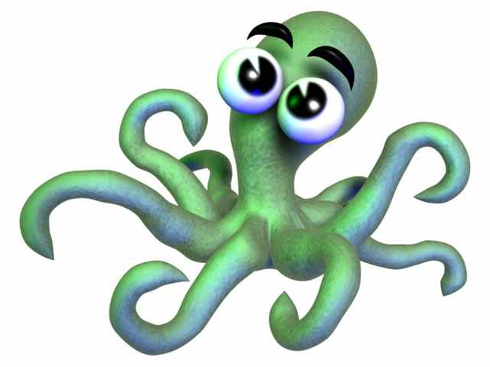
How would you create a Punnett Square for this family?

Slide 16
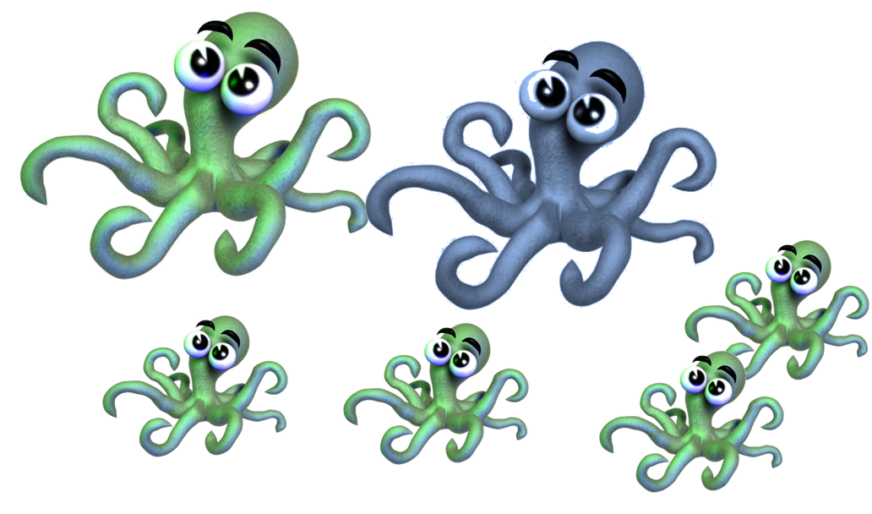
5 Steps of Punnett Square Problems
Step 1: Figure out the genotypes of the parents.
One is pretty simple – the recessive parent has to have two little letters: aa
The other has only two possibilities – AA or Aa
So we know that one parent is aa and the other is either Aa or AA.

Slide 17
5 Steps of Punnett Square Problems
Step 2: Figure out all possible offspring that the parents could have.
For all possible genotypes, figure out what the offspring would look like in each case.
i.e. make a Punnett Square for each possibility.

Slide 18
5 Steps of Punnett Square Problems
Step 3: Create the Punnett Squares
A a
A A
a
a
Aa aa
a
a
Aa Aa
Aa aa
Aa Aa

Slide 19
Step 4: Determine which Punnett Square is accurate
Select the Punnett Square that reflects what we see for offspring below.

Slide 20
5 Steps of Punnett Square Problems
Step 5: Confirm that you are correct.
You know that the Punnett Square on the left cannot be right because ½ the offspring are recessive.
A a
A A
a
a
Aa aa
a
a
Aa Aa
Aa aa
Aa Aa

Slide 21
How would you create a Punnett Square for this family?

Slide 22
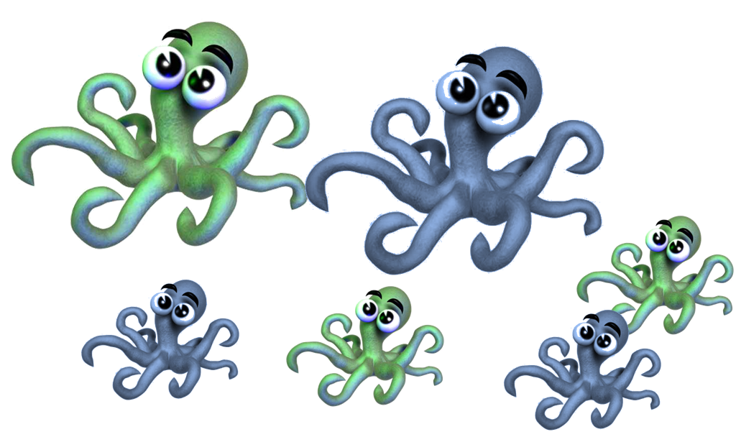
Step 1: Parent Genotypes
What would be the genotypes of the parents?
TPS

Slide 23
Step 2: Determine what offspring are possible from these parents.
What are the possibilities for the offspring?
TPS

Slide 24
Step 3: Create Punnett Squares for each possibility
Create Punnett Squares for all parent genotype combo possibilities

Slide 25
Step 4: Determine which Punnett Square is accurate
Select the Punnett Square that reflects what we see for offspring below.

Slide 26
Step 5: Confirm that you are correct.
Be prepared to explain why the other Punnett Square would not work.

Slide 27
Summary
Step 1: One parent is homozygous recessive: aa
The other parent is either Aa or AA
Step 2: these parents would either have mixed offspring or all dominant-phenotype offspring
Step 3: Create Punnett Squares

Slide 28
Summary
You know that the Punnett Square on the left is correct because half are the dominant phenotype and half are the recessive phenotype.
A a
A A
a
a
Aa aa
a
a
Aa Aa
Aa aa
Aa Aa

Slide 29
Summary
You know that the Punnett Square on the right is not correct because all of the offspring would be the dominant phenotype.
A a
A A
a
a
Aa aa
a
a
Aa Aa
Aa aa
Aa Aa
Step 5: Confirm the other Punnett Square is not correct.

Slide 30
How would you create a Punnett Square for this family?

Slide 31
Possible Combinations
With simple traits, there are only six possible combinations of parents
AA x AA
AA x Aa
Aa x Aa
AA x aa
Aa x aa
aa x aa
Each one will have the same results for offspring ratios each time.

Slide 32
Offspring Ratios
If we have only recessive phenotypes, we know that both parents are homozygous recessive – aa x aa
If we have half recessive, half dominant phenotypes, we know that one parent is Heterozygous and one parent is Homozygous Recessive – Aa and aa

Slide 33
Offspring Ratios
If we have ¼ recessive and ¾ dominant phenotypes, we know that both parents are Heterozygous – Aa and Aa
If all offspring are the dominant phenotype, we know that the combination of parents must be one of the following:
AA x AA Aa x AA AA x aa
Additional combinations would be necessary to determine which it is (except in the last example, where one parent has the recessive phenotype).

