Slide 1
Puberty & Hormones

Slide 2
Puberty
Most humans go through puberty in their early to mid teens.
During this period a number of reproductive hormones are activated in the body and females and males develop secondary sexual characteristics and their bodies are able to sexually reproduce.
Puberty along with the ability to sexually reproduce is a result of some key hormones.

Slide 3
Puberty
For males, puberty starts around 12/13 years old.
Can start as late as 16/17
Can start as early as 10/11
For females, puberty starts around 11/12
Can start as late as 16/17
Can start as early as 9/10
Some cases of some starting as early as 6 years old (rare)

Slide 4
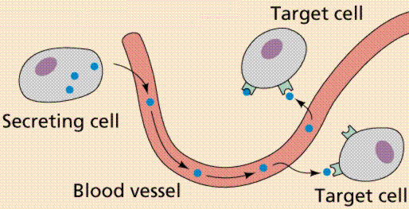
Hormones
Hormones are chemical messages the body uses to start or stop certain processes.
There is one hormone in particular that is responsible to begin puberty
Follicle stimulating hormone (FSH)

Slide 5
FSH
Once puberty begins the pituitary gland at the base of your brain begins to produce FSH.
This hormone travels through the bloodstream to the gonads to signal the production of gametes.
In a male the testes produce sperm
In a female the ovaries produce a mature egg.

Slide 6
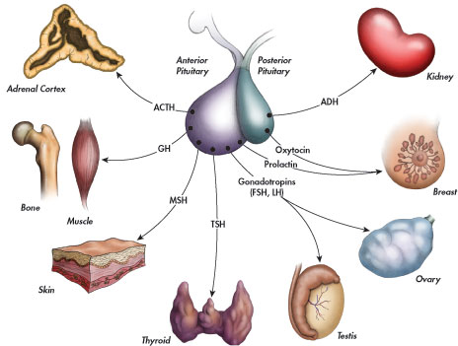
FSH
Once puberty begins the pituitary gland at the base of your brain begins to produce FSH.
This hormone travels through the bloodstream to the gonads to signal the production of gametes.
In a male the testes produce sperm
In a female the ovaries produce a mature egg.

Slide 7
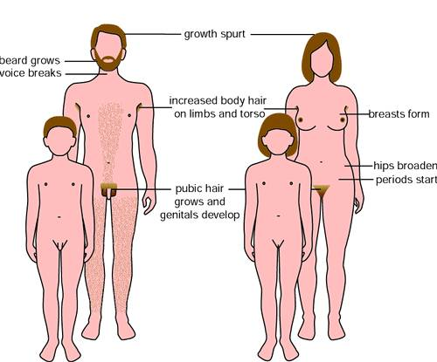
Secondary Sexual Characteristics
Other hormones help develop and maintain additional characteristics associated with being distinctly male and female. These are called secondary sexual characteristics.

Slide 8
Testosterone
Once FSH is produced and the testes are producing sperm, the testes begin to produce the hormone testosterone.
Testosterone is the hormone responsible for the secondary sexual characteristics of a male.
Secondary Traits in Male
Deepening of the voice
Production of facial hair
Production of underarm hair
Production of pubic hair
Broadening of shoulders
Growth Spurt

Slide 9
Estrogen
When FSH is produced in a female it stimulates the ovaries to produce estrogen.
Estrogen is responsible for the female secondary sexual characteristics.
Secondary Traits in Females
Deposits of fat in the breasts
Deposits of fat on the hips
Growth of pubic hair
Growth of underarm hair
Growth spurt

Slide 10
Ovulation
FSH and Estrogen are also involved in the ovulation process in a female.
Ovulation is when an immature egg begins to mature and is released into the fallopian tubes to be fertilized.
After puberty, each month the female body prepares for a possible pregnancy. This cycle is called the menstrual cycle.
http://www.youtube.com/watch?v=nLmg4wSHdxQ
http://www.youtube.com/watch?v=2-VKgdhfNpY

Slide 11
Textbook Questions
P. 90 #’s 1-3, 7,8

