Slide 1
Neutralization Reactions & pH Scale

Slide 2
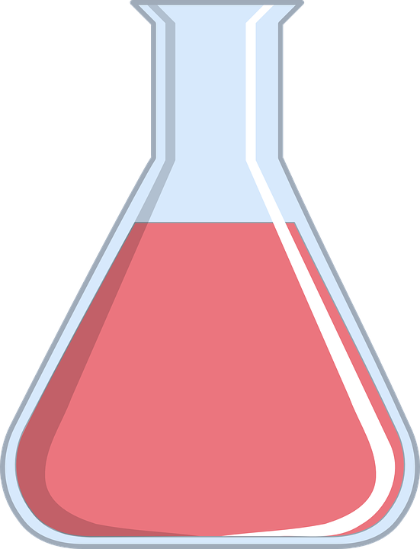
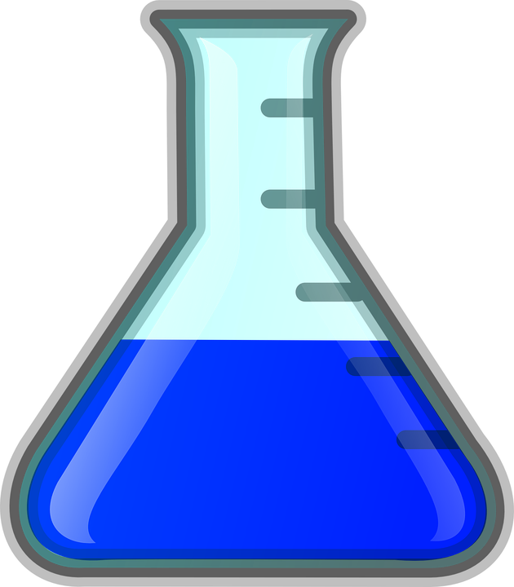
One more type of reaction
A neutralization reaction occurs when an acid and a base react to form products that have a pH closer to 7 than either of the reactants
HCl
pH=2.5
NaOH
pH=12.5
pH=7.5

Slide 3
Acid & Base combine
Acids form hydrogen ion in water (H⁺)
Bases form hydroxide ions in water (OH⁻)
When the H⁺ combines with the OH⁻, what does it create?
H⁺ + OH⁻ → HOH
What is HOH?
Rewritten it is H₂O - water

Slide 4
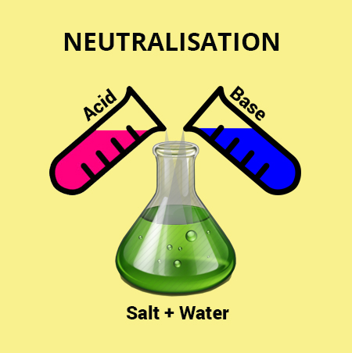
Predicting the Products of Neutralization Reactions
If we know the reactants of a neutralization reaction, we can predict the products
AB + CD → AD + CB
For example:
HCl _{(aq)} + NaOH _{(aq)} → HOH _{(l)} + NaCl_{(aq)}
Mixing hydrochloric acid (HCl) & Sodium Hydroxide (NaOH) makes salt water
This is a type of double displacement reaction

Slide 5
Try to predict the following
H₂SO₄ _{(aq)} + KOH _{(aq)} →
H₂SO₄ _{(aq)} + KOH _{(aq)} →
H₂SO₄ _{(aq)} + KOH _{(aq)} → HOH _{(l)} + K₂SO_{4 (aq)}
Now Balance
H₂SO₄ _{(aq)} + 2KOH _{(aq)} → 2HOH _{(l)} + K₂SO_{4 (aq)}
This is known as a SALT

Slide 6
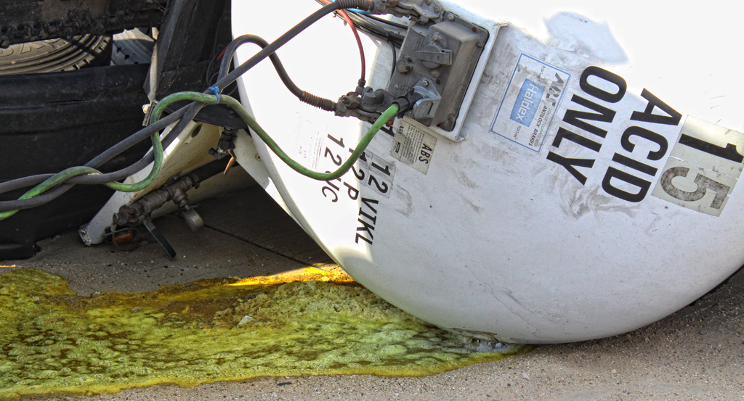
Chemical Spills
In March 2007 a train hauling 150 000 L of sulfuric acid derailed in Englehart northern Ontario.
The sulfuric acid killed fish, and posed a threat to both humans and wildlife
Emergency response crews added calcium hydroxide Ca(OH)₂(s) to the river to neutralize the acid
Ca(OH)₂ + H₂SO₄(aq) → 2H₂O(l) + CaSO₄(aq)

Slide 7
Universal Indicator pH Scale

Slide 8
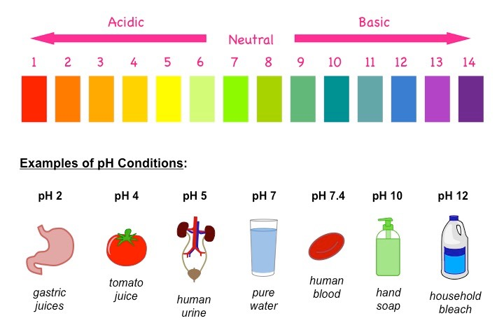
pH Scale
Each number on the scale represents a 10X change in strength.
Examples
pH of 5 is 10X stronger acid than a pH of 6
pH of 4 is 10X stronger acid than a pH of 5
So pH 4 is 100X stronger than pH of 6
pH of 10 is 10X stronger base than pH of 9
pH of 9 is 10X stronger base than pH of 8
So pH of 10 is 100X stronger than pH of 8

Slide 9
pH Scale
Try these
How much stronger acid is pH 2 compared to pH 4
How much stronger base is pH 14 compared to pH 13
How much stronger acid is pH 0 compared to pH 4
How much stronger base is pH 14 compared to pH 7
Try all the above
How much stronger on the pH scale is 14 compared to 0
← 100X
← 10X
← 10,000X
← 10,000,000X
100,000,000,000,000X
100 trillion times stronger

Slide 10
Assignment
1
(For # 7&13 identify only)
P. 171 #’s 1-5, 7-14 omit 12a
(For #7&13 identify only)

