Slide 1
Meiosis
Cell Division for Sexual Reproduction

Slide 2
Sexual Reproduction
In sexual reproduction, 2 individuals are required
Specifically the chromosomes of 2 individuals are required
If regular cells are used to create a new offspring, problems would arise

Slide 3
Human - Male
All humans have 46 chromosomes
Human -Female
46 Chromosomes
46 Chromosomes
This is what would occur if a regular cell from both male and female would be used to create offspring
XY
XX
Not human?
Humans must have 46 chromosomes
92 Chromosomes
XYXX

Slide 4
What if we continue this logic?
92 Chromosomes
92 Chromosomes
XYXX
XYXX
184 Chromosomes
XYXX XYXX

Slide 5
Special cells for Sexual Reproduction
Regular cells cannot be used for sexual reproduction
The number of chromosomes would double each generation ... Not possible
There must be a method to keep the total chromosomes the same between parent and offspring

Slide 6
New terms
Diploid: Cells that have a full number of chromosomes for that species
46 for humans
Haploid: Cells that have ½ the number of chromosomes for that species
23 for humans

Slide 7
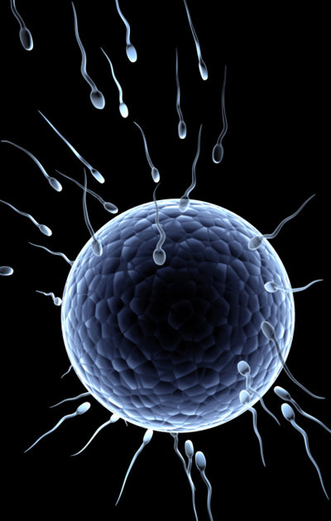
Gametes
The body create specialized cells called gametes for sexual reproduction
Males: Sperm
Females: Egg
These cells have ½ the normal number of chromosomes
This is called a Haploid cell – 23 for humans
A cell with a full set of chromosomes is called a Diploid Cell – 46 for humans

Slide 8
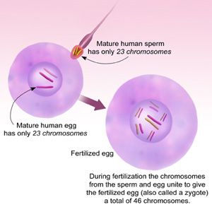
Fertilization
The process of 2 gametes combining to form a new individual is called fertilization
When the sperm and egg fuse together, a new full cell (Diploid) is created – the start of a new individual with unique chromosomes
This cell is called a zygote

Slide 9
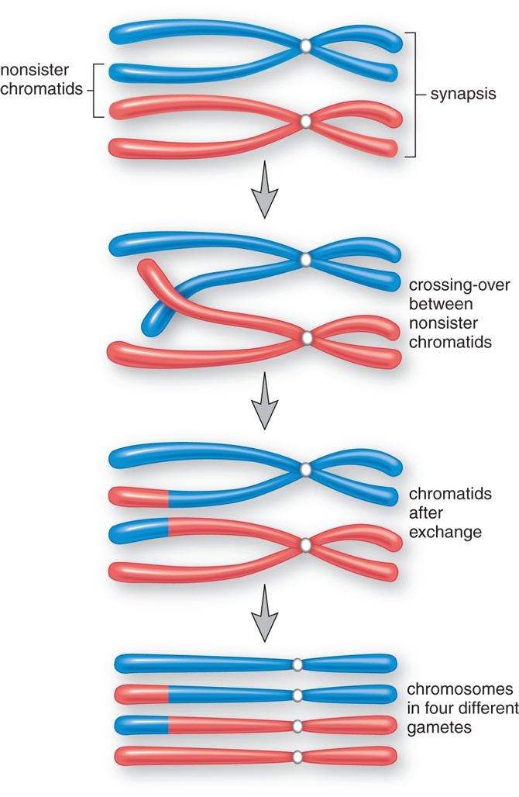
Meiosis
Meiosis is the process of how the cell creates the specialized gamete cells
Some similarities to mitosis
Some major differences
The cell division needs:
To create a cell with ½ the normal chromosomes
To create a variation in the chromosomes possible

Slide 10
Meiosis Animation
http://www.sumanasinc.com/webcontent/animations/content/meiosis.html

