Slide 1
Sir Isaac Newton Laws of Motion

Slide 2
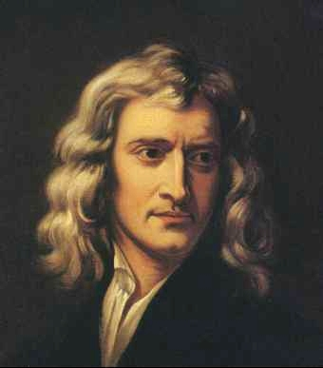
Sir Isaac Newton
Described 3 laws that relate forces to motion
Force-a push or a pull, all forces have size and direction

Slide 3
Vocabulary
Friction- a force that opposes motion between 2 objects that are touching
Inertia-tendency of all objects to stay at rest or in motion
Mass- the amount of matter an object is made of

Slide 4
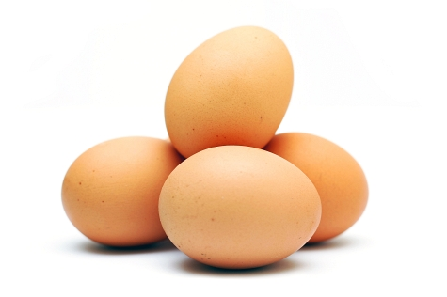
Newtown’s 1st Law of Motion “Law of Inertia”
An object at rest remains at rest and an object in motion remains in motion at constant speed and in a straight line unless acted on by an unbalanced force

Slide 5
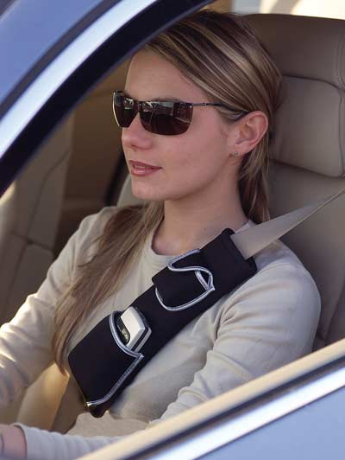
Examples of Newton’s 1st Law of Motion
Car suddenly stops and you strain against the seat belt
Car turns left and you appear to slide to the right
The difficulty of pushing a car that won’t start

Slide 6
Examples of Newton’s 1st Law of Motion
Video
Video

Slide 8
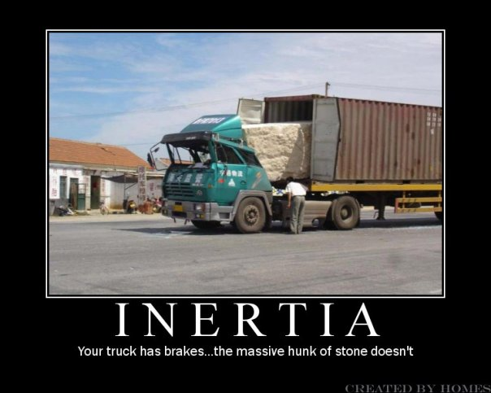

Slide 9
Examples of Newton’s 1st Law of Motion

Slide 10
Newton’s Second Law of Motion
The acceleration of an object depends on the mass of the object and the amount of the force applied

Slide 11
Newton’s Second Law of Motion
Force = mass x acceleration
$$F=m x a$$
Force- a push or pull, all forces have size and direction
Mass- the amount of matter an object is made of
Acceleration-the rate at which velocity changes
objects accelerate if its speed changes, if its direction changes and if both speed and direction changes

Slide 12
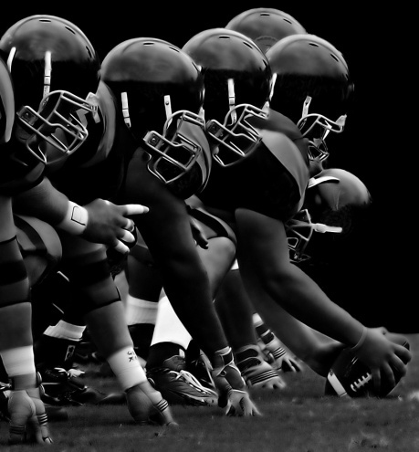
Examples of Newton’s 2nd Law
Hitting a softball, the harder the hit, the faster the ball goes
Football players and their positions
Loaded versus an unloaded truck

Slide 13
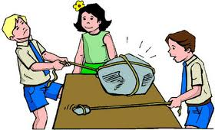
Examples of Newton’s 2nd Law

Slide 14
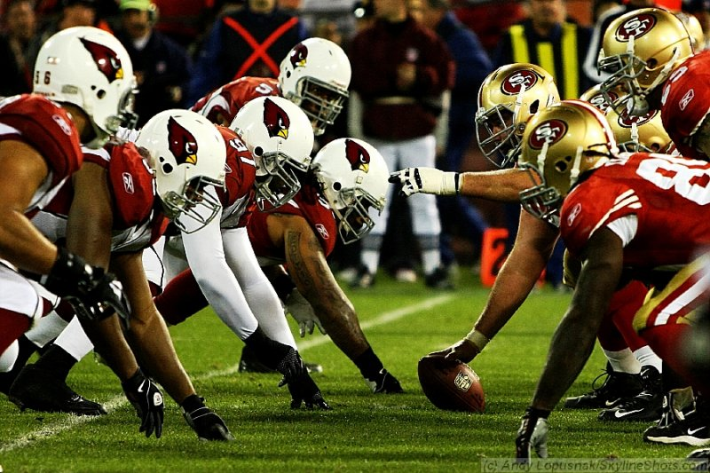
Examples of Newton’s 2nd Law

Slide 15
Newton’s Third Law of Motion
For every force, there is an equal and opposite force
Action and Reaction

Slide 16
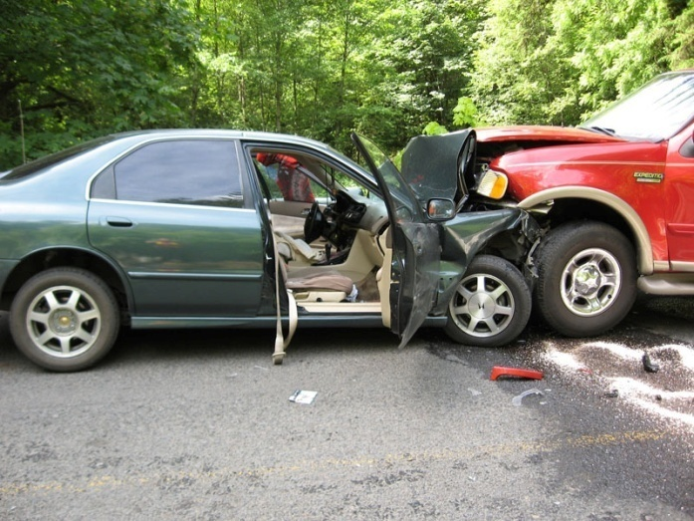
Examples of Newton’s 3rd Law
2 cars hit head on
Jumping out of a boat onto a dock
Astronauts in space

