Slide 1
Forms of Reproduction (2 major categories)

Slide 2
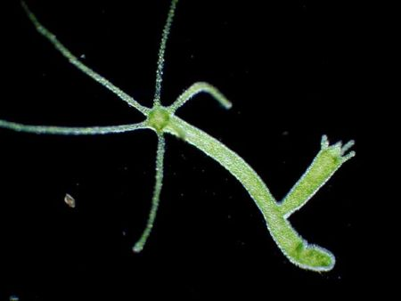
Asexual Reproduction
Asexual: It is the method of reproduction where only 1 individual is required to reproduce.
Example: Bacteria, plants (cuttings)
NOTE: The parent and offspring have exactly the same genetic (DNA) information - Clone

Slide 3
Sexual Reproduction
Sexual: It is the method of reproduction where 2 individuals are required to reproduce.
Example: Mammals, reptiles, amphibians, birds, fish, plants (flowering)
NOTE: The parents and offspring have different genetic information

Slide 4
5 Methods of Asexual Reproduction
Binary Fission
Occurs in unicellular organism
Uses mitosis to divide in half.
Video 1
Video 2
Video 3
Video 4

Slide 5
5 Methods of Asexual Reproduction
Budding
In unicellular organisms, parent keeps most of the cytoplasm
In multicellular organisms, a miniature version grows on parent
Called the bud
When large enough, detaches and is independent.
Video 1
Video 2
Video 3

Slide 6
5 Methods of Asexual Reproduction
Sporulation
Organism creates reproductive cells (spores) by mitosis
These cells are stored in sporangia
Burst open and grow into new individuals
Video 1
Video 2
Video 3
Video 4
Video 5

Slide 7
5 Methods of Asexual Reproduction
Vegetative propagation
New individual is created from
Root or
Stem or
Leaves
Video 1
Video 2

Slide 8
5 Methods of Asexual Reproduction
Regeneration
Multicellular organism is divided into fragments
Each fragment becomes a new organism by re-growing parts it is missing
Only method of Asexual reproduction that may occur in complex animals
Video 1
Video 2
Video 3

Slide 9
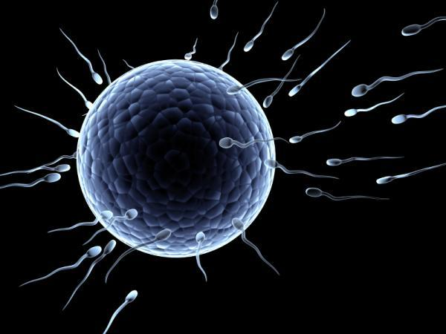
Sexual reproduction
Specialized cells from parents must join (fertilization) to create a new individual
Sperm from Male
Egg from female
Offspring are genetically different from both parents
May have some similar traits

Slide 10
2 Methods of Sexual Reproduction
External Fertilization
Sperm and egg join outside the body of either parent
Join in the environment
Ex.
Video 1
Video 2
Video 3

Slide 11
2 Methods of Sexual Reproduction
Internal Fertilization
Sperm and egg join inside the body of one of the parents
Usually female
Ex.
Egg/Sperm size comparison

