Slide 1
Position Graph - Slope

Slide 2
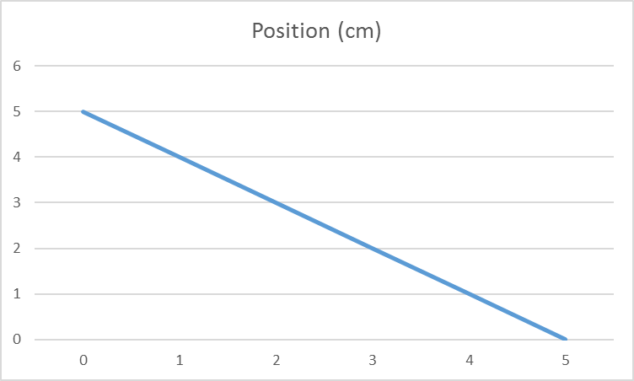
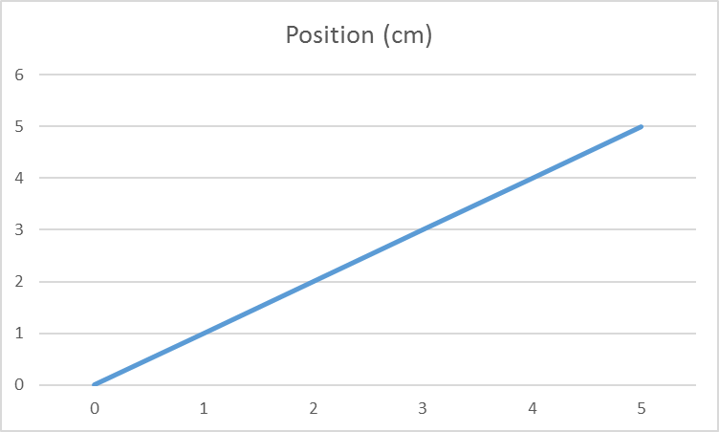
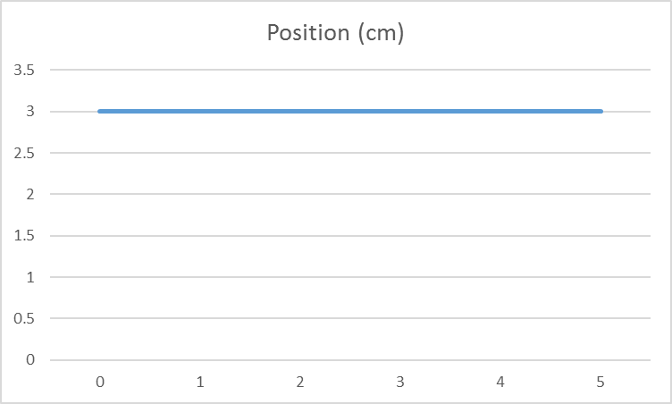
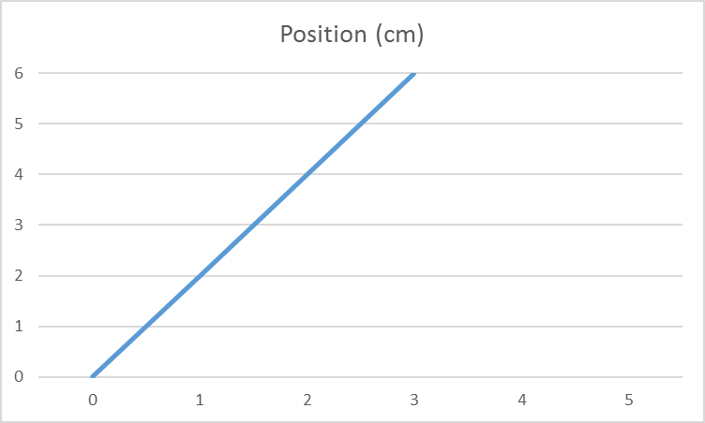
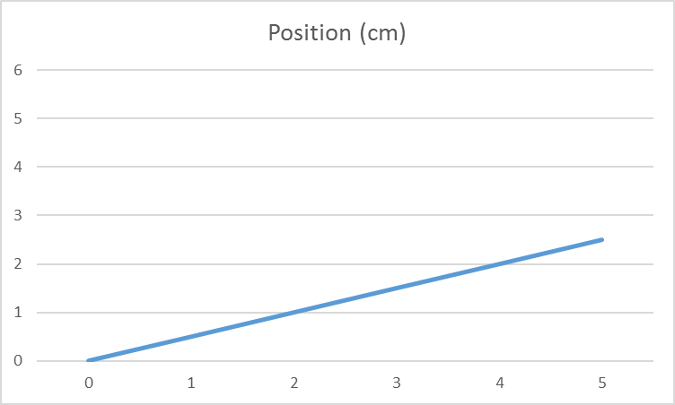
Position Graph shape
The shape of a position graph gives us information about the motion of an object
Constant slope →
Flat line →
Upward slope →
Downward slope →
Steep slope →
Shallow slope→
Constant velocity (Uniform motion)
No motion (Stationary)
d
Moving forwards (+ motion)
Moving backwards (- motion)
Moving fast
Moving slow
t

Slide 3
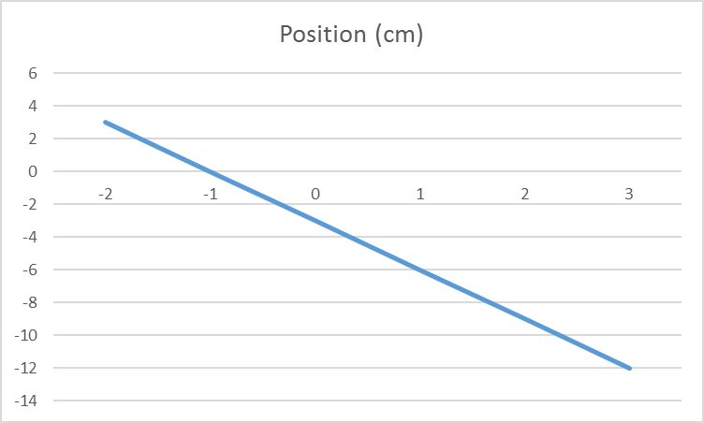
What can you all say about the following graph
Constant motion
Uniform
Moving backwards (-)
Fast
Begins front of origin
Ends behind origin

Slide 4
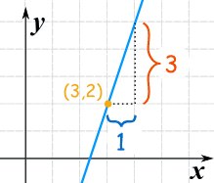
How to give slope a value (Number)
We must compare how much the graph changes over both measurements
Need to know a change in position
Need to know a change in time
$$Slope=\frac{rise}{run}$$
$$Slope=\frac{∆y}{∆x}$$
$$Slope=\frac{3}{1}$$
$$Slope=3$$

Slide 5
Connect to position Graph
The y axis for our graph is position
The x axis for our graph is time
$$Slope=\frac{∆d}{∆t}$$
$$Slope=\frac{3}{1.5}$$
$$Slope=2$$
What are the units?
$Slope=2m/s$
What is this measuring?
Position vs. Time
Position [m]
3
1.5
Time [s]

Slide 6
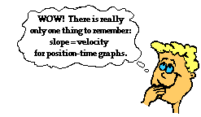
Slope of position graph is velocity

Slide 7
Connect to position Graph
For a constant slope, any two points can be used to calculate the slope
Position vs. Time
Position [m]
3
1.5
Time [s]

Slide 8
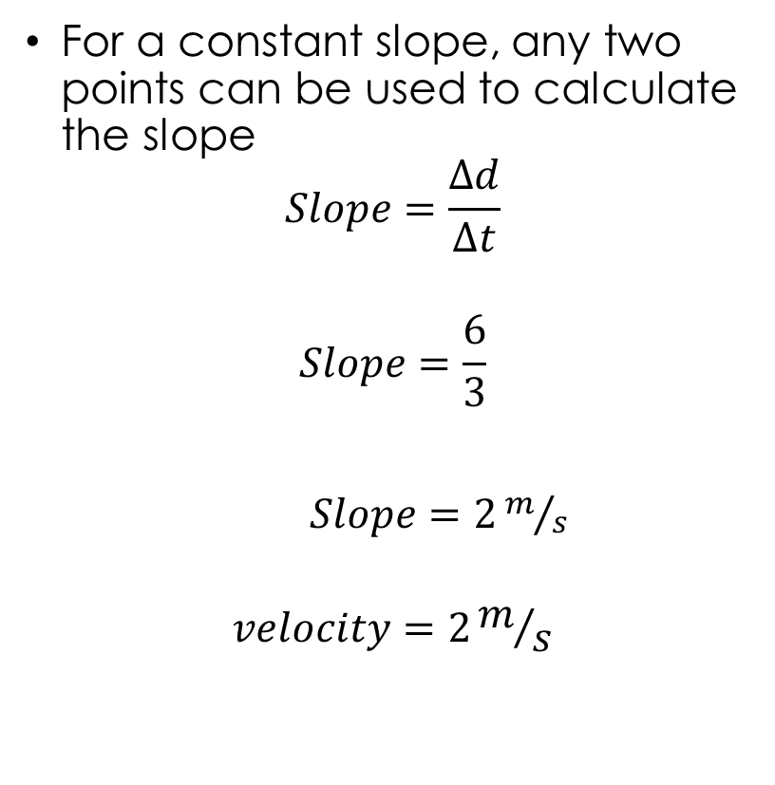
Connect to position Graph
For a constant slope, any two points can be used to calculate the slope
$$Slope=\frac{∆d}{∆t}$$
$$Slope=\frac{6}{3}$$
$Slope=2m/s$
$$velocity=2m/s$$
Position vs. Time
Position [m]
6
3
Time [s]

Slide 9
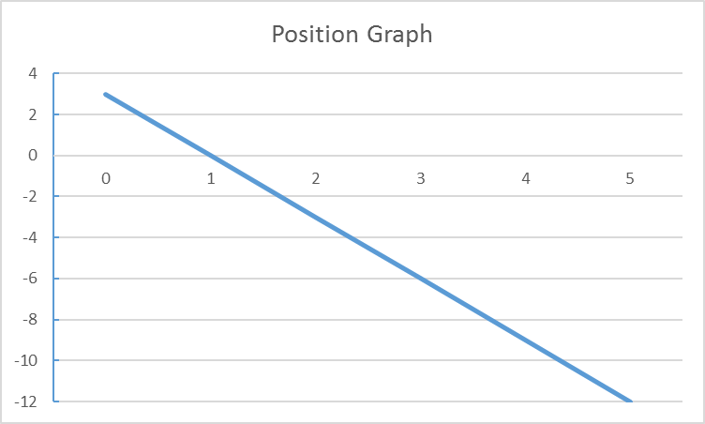
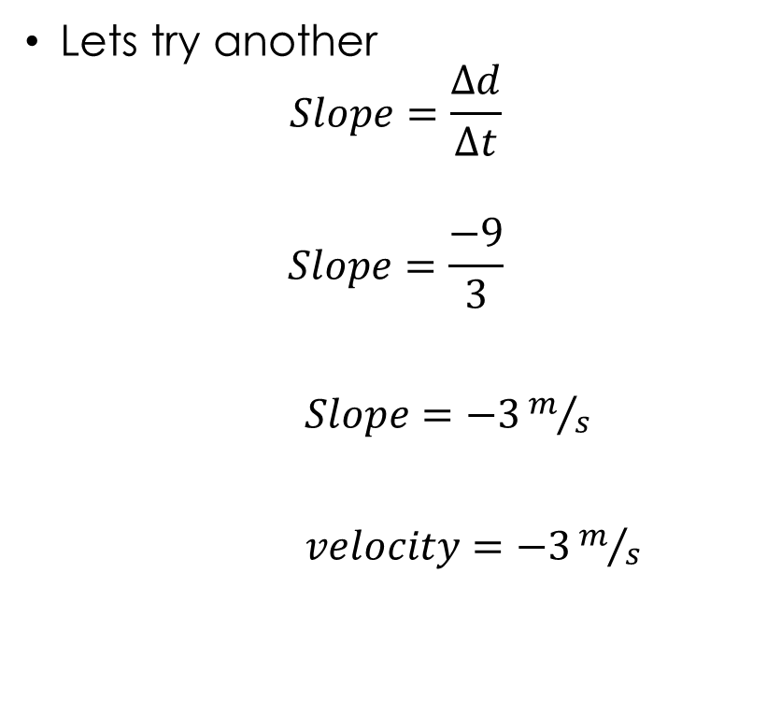
Lets try another
$$Slope=\frac{∆d}{∆t}$$
$$Slope=\frac{−9}{3}$$
$Slope=−3m/s$
$velocity=−3m/s$
Position vs. Time
Position [m]
-9
Time [s]
3

