Slide 1
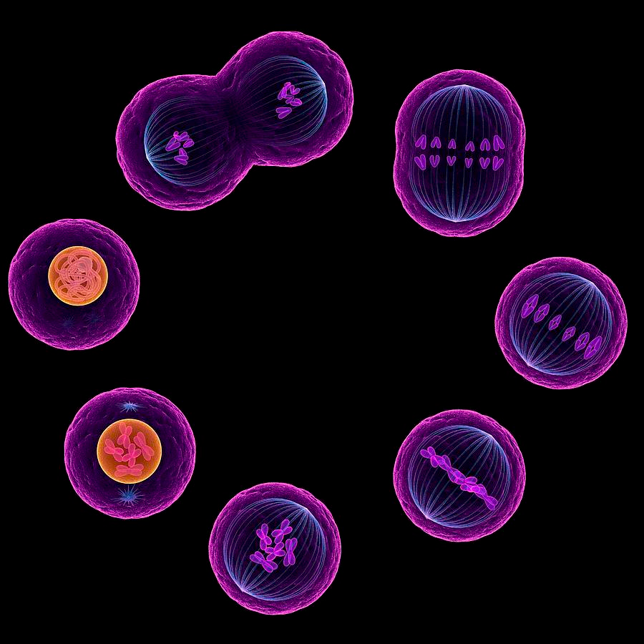
Mitosis
Cell Division/Duplication

Slide 2
Stages of the Cell Cycle
1 stage of cell growth and preparation for Mitosis
4 stages of Mitosis
Prophase
Metaphase
Anaphase
Telophase
Cycle repeats
Time spent in each phase of Mitosis

Slide 3
Interphase
Cell Experiences major growth in size.
Prepares for mitosis.
Majority of time of a cell’s cycle is in interphase
Time spent in each phase of Mitosis

Slide 4
Interphase
Cell Membrane
Maternal Chromosomes
(From Mother)
Chromosomes of the same length hold similar information – Called Homologous Pair
Nucleus
Paternal Chromosomes
(From Father)

Slide 5
Mitosis Phase 1 – Prophase
Centromere
(Connects sister chromatids)
All Chromosomes have duplicated
Centrioles begin to move to opposite sides of nucleus
Sister chromatids
(Identical DNA)
Nucleus begins to dissolve

Slide 6
Prophase Summary
Chromosomes Duplicated
Centrioles begin to move
Nucleus begins to dissolve

Slide 7
Phase 2 - Metaphase
Spindle Fiber
Nucleus disappears
Chromosomes line up in the middle
Centrioles move to far sides of cell
Spindle fibers connect to the centromeres

Slide 8
Metaphase Summary
Nucleus disappears
Chromosomes line up in the middle
Centrioles move to opposite sides of the cell
Spindle fibers are very noticeable and connect to the centromeres

Slide 9
Phase 3 - Anaphase
Spindle Fibers begin to contract
Each duplicated chromosome splits and begin to move to opposite poles of the cell

Slide 10
Anaphase Summary
Spindle fibers begin to contract
Duplicated chromosomes split

Slide 11
Phase 4 - Telophase
Cell begins to pinch in the middle – Start of 2 cells
Spindle fibers contract further
2 Nuclei begin to form

Slide 12
Telophase Summary
Cell begins to pinch in the middle
Chromosomes are almost at the opposite ends
Nuclei begin to form

Slide 13
2 New Cells
2 new cells are created
The 2 new cells are genetically identical – Same chromosomes
The 2 new cells are called Sister Cells

Slide 14
Telophase
Anaphase
Interphase
Prophase
Metaphase

Slide 15
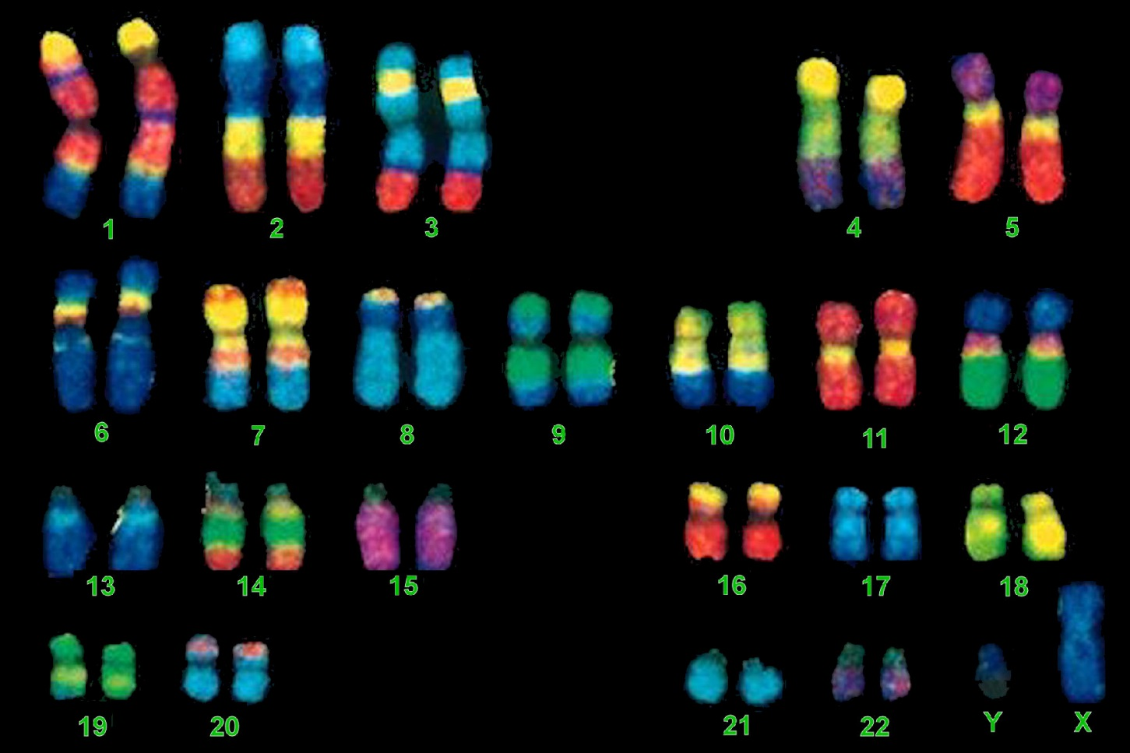
Human Chromosomes
46 total
23 pairs
Cell containing all 46 chromosomes is called a Diploid Cell

Slide 17
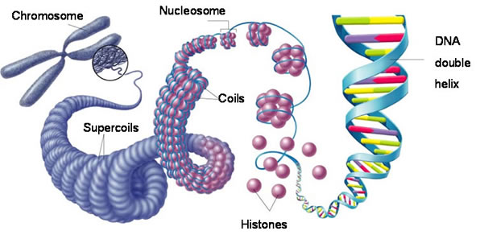
DNA/Chromosome Relationship

