Slide 1
Standing Waves

Slide 2
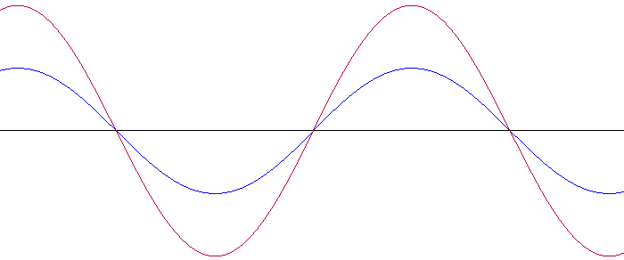
Definition
A Standing Wave/Stationary wave is the resultant wave of two waves of the same amplitude, wavelength, frequency (thus also velocity) traveling in opposite directions through the same medium.
The resultant wave appears to be standing still (neither moving left of right)

Slide 3
Superposition/Interference
Standing waves are the result of superposition of 2 (or more) waves
Applet

Slide 4
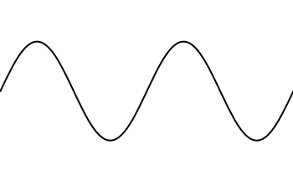
Parts of a Standing wave
Node: Parts of a standing wave where the medium has no/minimum amplitude
Antinode: Parts of a standing wave with the maximum amplitude

Slide 5
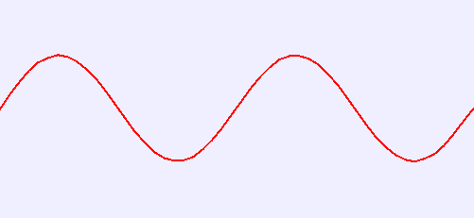
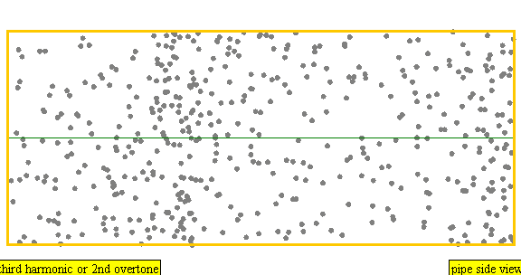
How many Nodes & Antinodes
Node: 3
Antinode: 4
Node: 3
Antinode: 2
Node: 5
Antinode: 4
Node: 4
Antinode: 3

Slide 6
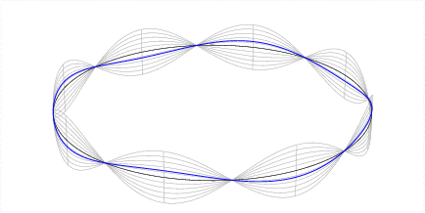
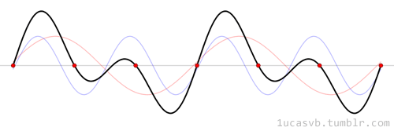
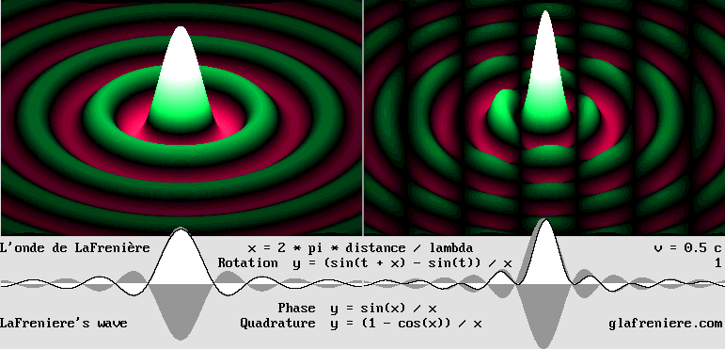
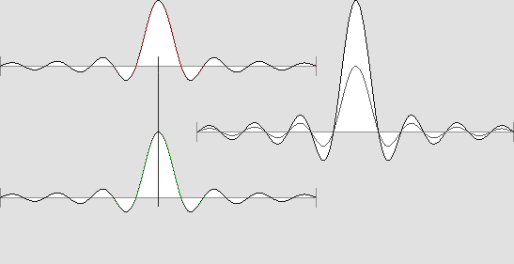
Other types of standing waves

Slide 7
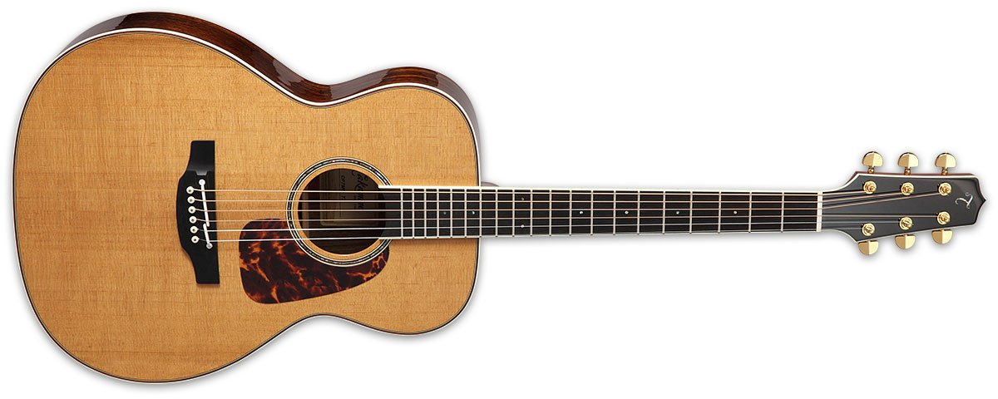
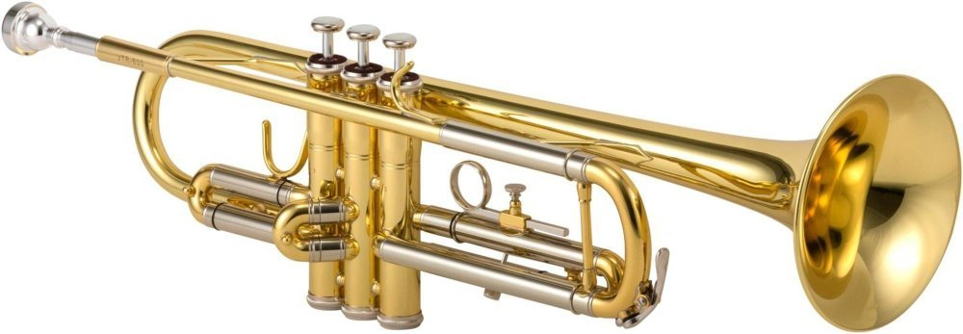
Instruments Use Standing Waves
The note played by an instrument is related to a standing wave produced in the instrument
String for guitars, pianos, violins….
The standing wave/pitch can be adjusted by;
Density of string
Tension in string
Length of string
Air for trumpets, saxophone, flute….
The standing wave/pitch can be adjusted by;
Length of tube
Open vs. closed end of tube
Adjusting source frequency (buzzing of lips)

Slide 8
String standing wave
Both ends must be fixed
$∴$ Both ends must be nodes
There will always be one more node than antinode

Slide 9
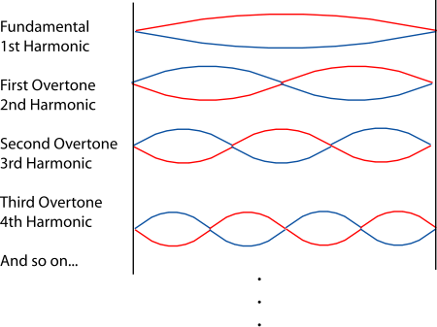
String standing wave
Both ends must be fixed
$∴$ Both ends must be nodes
There will always be one more node than antinode
Applet
$$f$$
$$2f$$
$$3f$$
$$4f$$

Slide 10
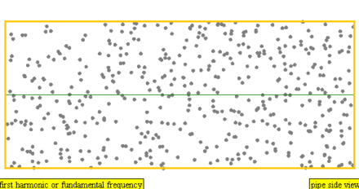
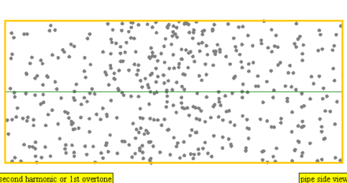
Tube Standing Waves
The medium of air is a longitudinal wave

Slide 11
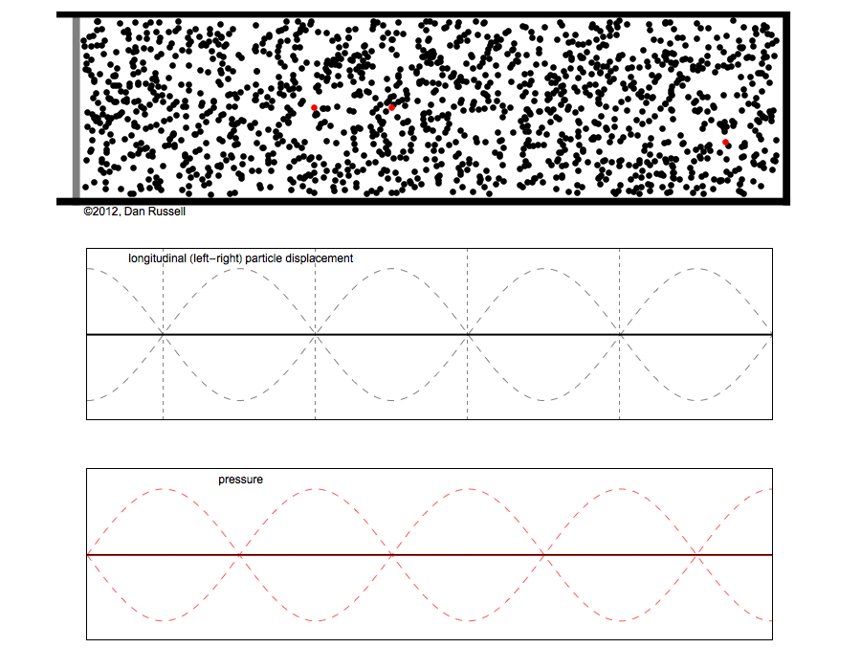
Tube Standing Waves
The medium of air is a longitudinal wave
Helps to view it as a transverse wave

Slide 12
Tube Standing Waves
3 options
Both ends open
Both ends are antinodes
Always one more antinode than node
One end open, one end closed
One end node, other antinode
Equal number of nodes/antinodes
Both ends closed
Both ends are nodes
Always one more node than antinode
Applet

Slide 13
Standing Wave Equation
$$L=\frac{n}{2}λ$$
$L=length of tube or string$
$\begin{aligned}n=\# of loops\end{aligned}$
$λ=wavelength$
$How many loops are in each situation$?
$$n = ½$$
$$n =1$$
$$n =1½$$
$$n =2$$
$$n =2 ½$$
$$n =3$$

Slide 14
Standing Wave Equation
If the instrument is a string instrument, the wave moves from one medium into another
String → Air
$∴$ the frequency can be changed in the string by adjusting tension, but the wavelength within the string remains the same.
However, because the sound is transferred from the string into the air, both the wavelength of the wave and the frequency change in the air, giving a constant velocity, the speed of sound.

Slide 15
Standing Wave Equation
If the instrument is a wind instrument, there is no transfer between mediums
$∴$ changing the frequency can only be done by changing the wavelength/length of the tube. The velocity of the wave remains the same.
$∴$ The standing wave equation $L=\frac{n}{2}λ$ along with the wave equation $v=λf$ can be used to determine the frequency/pitch of the wave

Slide 16
Standing Wave Equation
Example 1
Original organs were a series of different length pipes. If the largest pipe is 2.675m long and is closed on one end and open on the other, what is the largest (fundamental) wave it can produce?
If the speed of sound is ~343m/s, what is the frequency of the wave?

Slide 17
Standing Wave Equation
Example 2
A pipe for an organ needs to produce a note of middle C (262Hz). What length of tube is needed if;
The tube is open on one side and closed on the other
The tube is open on both sides

Slide 18
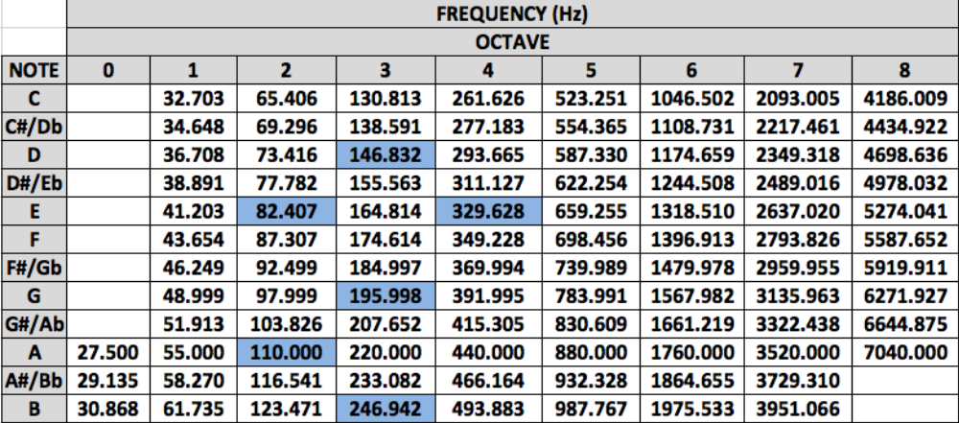

Slide 19
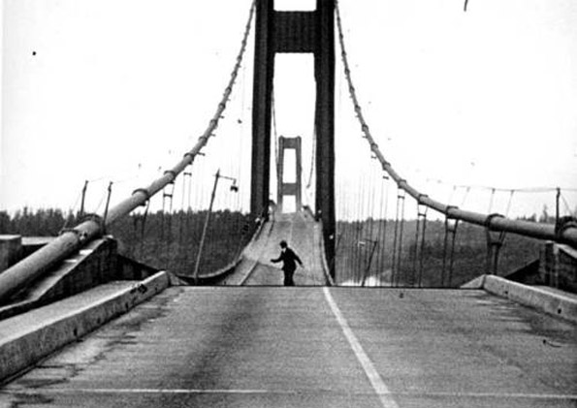
Standing wave Disaster
Tacoma Narrows Bridge Collapse

