Slide 1
Reproduction
Introduction

Slide 2
Concept Overview THE CELL
Take 10-12 minutes to complete the concept overview
The Cell is the concept or word you are using

Slide 3
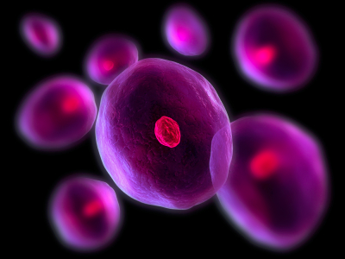
THE CELL
Cell: The smallest living unit
5 Kingdoms of life
Plant
Animal
Fungi
Monera (Bacteria)
Protista (Algae)
Two criteria to be living:
Must take in and use energy
Be able to reproduce

Slide 4
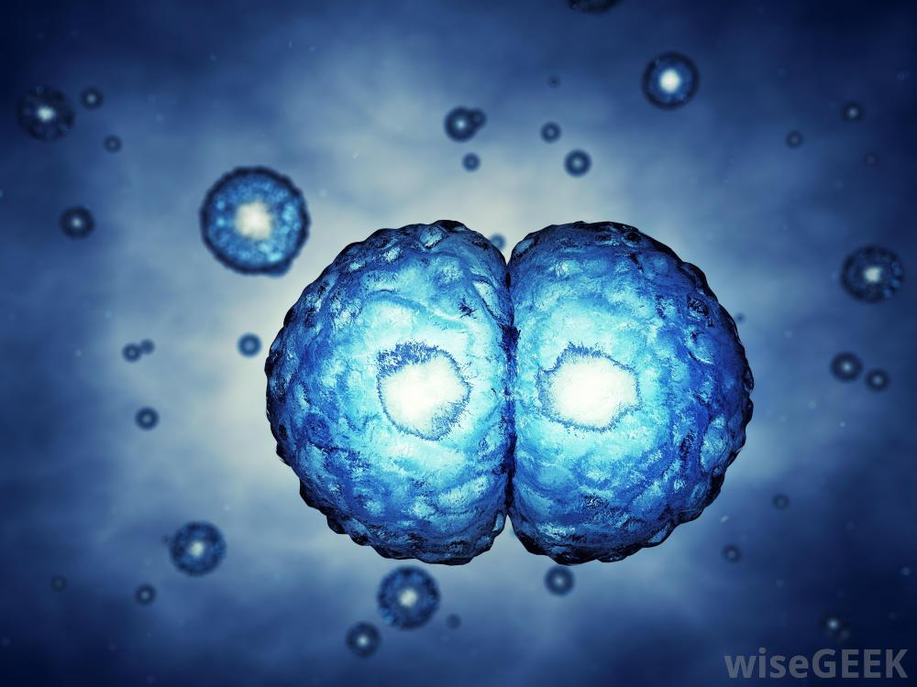
Why do cells reproduce?
They die (need to be replaced)
No energy
Old age (“Programed” to die at a particular time)
Lack of nutrients (Ex. Oxygen)
Damaged (Ex. Cut, burn)
Damage to body (Repair)
Growth of individual

Slide 5
Cell Parts
Cell Membrane
Chromosomes (4 in this pic)
Chromosomes that are the same length are a Homologous Pair. Each chromosome in the pair holds similar information
Nucleus
Different Species have different # of chromosomes. Humans have 46 chromosomes in each body cell.

