Slide 1
Chemical Naming and Formulas
Nomenclature

Slide 2
IUPAC
International Union of Pure and Applied Chemistry
Group of chemists that decide the rules of naming and chemical formulas
There have been some different rules in the past, changed about 25-30 years ago to make things more standard and current

Slide 3
3 sets of rules
There is a different set of rules for chemical naming
Ionic
Covalent
Organic
Entire unit in Chemistry 30S
We will only cover Ionic & Covalent

Slide 4
Covalent Naming
With covalent compounds, it is possible for different ratios between the same elements to create different compounds
Ex
CO
CO2
We need a method to name these differently as they have different properties
Remember: Covalent is between 2 non-metals

Slide 5
Covalent Naming Con’t
Rules
The elements are named in the order they appear
Prefixes are used to indicated the number of atoms of that element
The prefix for 1 is not used on the first element
The second element suffix is changed to -ide

Slide 6
Covalent Naming Con’t
Prefixes
1 Mono
2 Di
3 Tri
4 Tetra
5 Penta
6 Hexa
7 Hepta
8 Octa
9 Nona
10 Deca
MUST MEMORIZE

Slide 7
Covalent Naming Con’t
Example 1:
Question: Is this 2 non-metals?
CO
YES → Covalent
Carbon
Mon
Oxygen
oxide
1 Carbon = Mono
But prefix for one is not used on first element
1 Oxygen = Mono
Change suffix to ide

Slide 8
Covalent Naming Con’t
Example 2:
Question: Is this 2 non-metals?
N2O5
YES → Covalent
nitrogen
Penta
oxide
Di
oxygen
2 Nitrogen = Di
5 Oxygen = Penta
Change suffix to ide

Slide 9
Covalent Naming Con’t
Example 3:
Question: Is this 2 non-metals?
N2S5
YES → Covalent
nitrogen
Penta
sulfur
Di
sulfide
2 Nitrogen = Di
5 Sulfur = Penta
Change suffix to ide

Slide 10
Covalent Naming Practice
Name the following
CO₂
CO
CCl₄
N₂O₄
SF₆
P₂Cl₅
PI₃
P₅Cl₈
Carbon dioxide
Carbon monoxide
Carbon tetrachloride
Dinitrogen tetraoxide
Sulfur hexafluoride
Diphosphorus pentachloride
Phosphorus triodide
Pentaphosphorus octachloride

Slide 11
Covalent formula writing
Writing the formula is backwards from writing the name
Rules
Write the element symbol for the elements – in order
Add the number that corresponds to the prefix for each element
The number 1 is never added

Slide 12
Covalent formula writing Con’t
Example 1:
Question: Is this 2 non-metals?
Silicon tetrachloride
YES → Covalent
Si
Cl
4
Silicon: No prefix = 1
Chlorine: Tetra = 4

Slide 13
Covalent formula writing Con’t
Example 2:
Question: Is this 2 non-metals?
Dinitrogen pentaoxide
YES → Covalent
N
O
2
5
Nitrogen: Di = 2
Oxygen: Penta = 5

Slide 14
Covalent Formula – Practice
Write the formulas for the following
Tetranitrogen decaoxide
Disulfur pentafluoride
Hexaselenium tribromide
Nitrogen monoxide
Aluminum Chloride
N₄O₁₀
S₂F₅
Se₆Br₃
NO
IONIC – Metal & Non-metal

Slide 15
Ionic Naming
Separated into 3 types
Monatomic
2 elements involved
Transitional Metals
Can be monatomic, but specifically has transitional metals, which demand some extra consideration
Polyatomic
Ions that are comprised of more than one element
We will only cover Monatomic & Transitional Metals

Slide 16
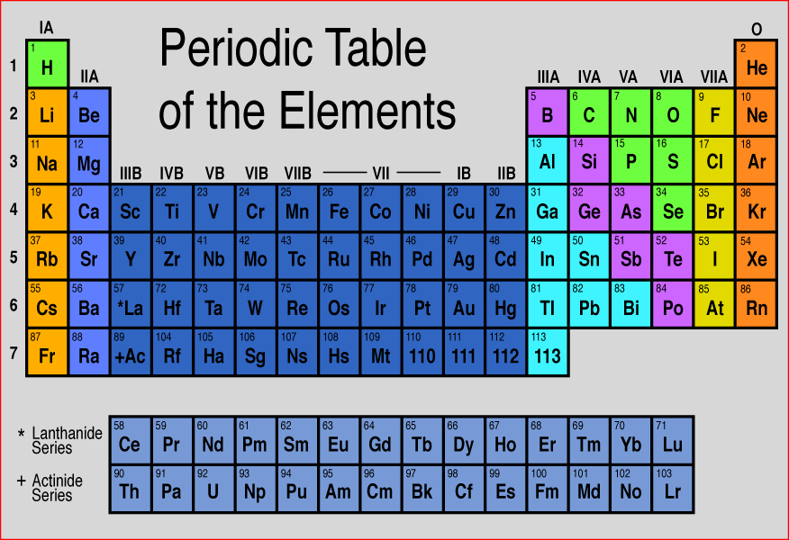
Ionic Naming
The location of an element on the Periodic Table can be used to determine the charge of some elements.
+1
+2
+3
-3
-2
-1
Various Charges
(Transitional Metals)

Slide 17
Ionic Naming - Monatomic
Since given ions can only combine in 1 way due to charges, no prefixes are used
In Sodium Chloride (NaCl), there is never any other ratio than 1 sodium & 1 chlorine
Rules
Cation (+ve) listed first, Anion (-ve) listed second
2nd ion suffix changed to -ide
No # prefixes used as only one possible combination with ions involved

Slide 18
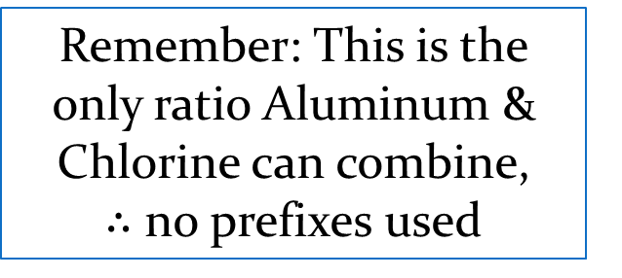
Ionic Naming - Monatomic
Example 1
AlCl3
Aluminum
Chlorine
Chloride
Remember: This is the only ratio Aluminum & Chlorine can combine, $∴$ no prefixes used
Change suffix to -ide

Slide 19
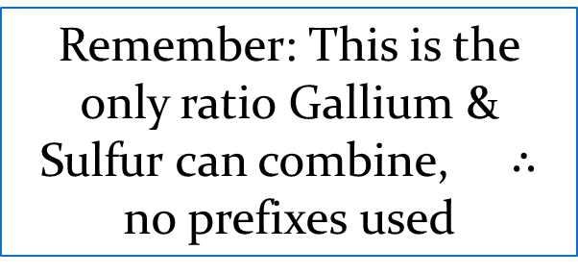
Ionic Naming - Monatomic
Example 2
Ga₂S₃
Sulfide
Gallium
Sulfur
Remember: This is the only ratio Gallium & Sulfur can combine, $∴$ no prefixes used
Change suffix to -ide

Slide 20
Ionic Formula - Monatomic
Rules
Formula must be neutral
Cation (+ve) listed first, Anion (-ve) listed second

Slide 21
Ionic Formula - Monatomic
Entire unit MUST be neutral
Add appropriate # of each ion to balance charges
Example 1
Aluminum Fluoride
Determine charge for each ion
Al³⁺
F⁻
Determine if charges balance
+3 -1 = +2
Adjust lower charge ion
Al³⁺
F⁻ F⁻ F⁻
Double check that it balances
+3 -3 = 0
Combine Ions
AlF₃

Slide 22
Ionic Formula - Monatomic
Example 2 Gallium Oxide
Determine charge for each ion
Ga³⁺
O²⁻
Determine if charges balance
+3 -2 = +1
Adjust lower charged ion
Ga³⁺
O²⁻ O²⁻
Double check that it balances
+3 -4 = -1
Adjust other ion
Ga³⁺ Ga³⁺
O²⁻ O²⁻
Double check that it balances
+6 -4 = +2
Adjust as needed
Ga³⁺ Ga³⁺
O²⁻ O²⁻ O²⁻
+6 -6 = 0
Combine Ions
Ga₂O₃

Slide 23
Ionic Formula Practice
Write the formulas for the following
Lithium Sulfide
Magnesium Bromide
Hydrogen Nitride
Aluminum Phosphide
Boron Sulfide
Li₂S
MgBr₂
H₃N
AlP
B₂S₃

Slide 24
Ionic Naming – Transitional Metals
Most of the transitional metals can have more than one charge
Examples
Fe²⁺
Fe³⁺
The name must somehow reflect which charge exists on the Transitional Metal
ONLY done for transitional metals

Slide 25
Ionic Naming – Transitional Metals
Roman numerals are used to indicate the charge on the transitional metal
Examples
Fe²⁺ Iron II
Fe³⁺ Iron III
Roman numerals
1 I
6 VI
2 II
7 VII
3 III
8 VIII
MUST MEMORIZE
4 IV
9 IX
5 V
10 X

Slide 26
Ionic Naming – Transitional Metals
Example 1
TiO₂
Oxide
Titanium
Oxygen
IV
Change suffix to -ide
Write the charges known
1(?) + 2(-2) = 0
Find charge to make zero
1(+4) + 2(-2) = 0
Found charge of metal

Slide 27
Ionic Naming – Transitional Metals
Example 2
Fe₂O₃
Oxide
III
Oxygen
Iron
Change suffix to -ide
Write the charges known
2(?) + 3(-2) = 0
Find charge to make zero
2(+3) + 3(-2) = 0
Found charge of metal

Slide 28
Ionic Naming – Transitional Metals Practice
Find the names for the following
Cu₃P
CoO
PbCl₂
CrN₂
Copper I Phosphide
Cobalt II Oxide
Lead II Chloride
Chromium VI Nitride

Slide 29
Common Names
Some chemicals are used so often and have names in everyday language that you need to be familiar with the name/formula
Water H2O
Ammonia NH3

Slide 30
Common Names - Diatomic
There are 7 elements on the periodic table that are so commonly used, you also need to know their names and formulas
Nitrogen N₂
Oxygen O₂
Fluorine F₂
Chlorine Cl₂
Bromine Br₂
Iodine I₂
Hydrogen H₂

